Slide 1

Health Checks
Health checks are self-diagnostic endpoints that test the application.
Formalized as Health and Readiness Probes in Kubernetes.

Slide 2
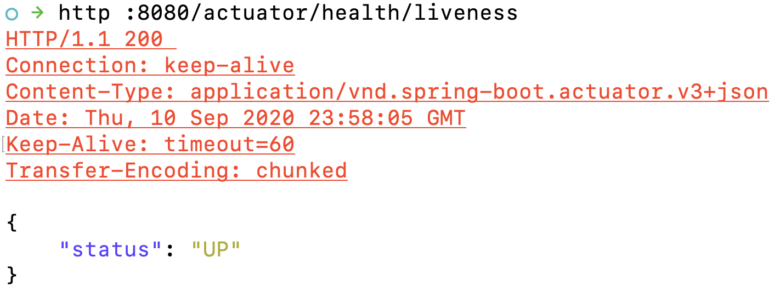
Spring Boot Actuator Kubernetes Liveness Check
Kubernetes restarts containers that fail a series of liveness checks in a time interval

Slide 3
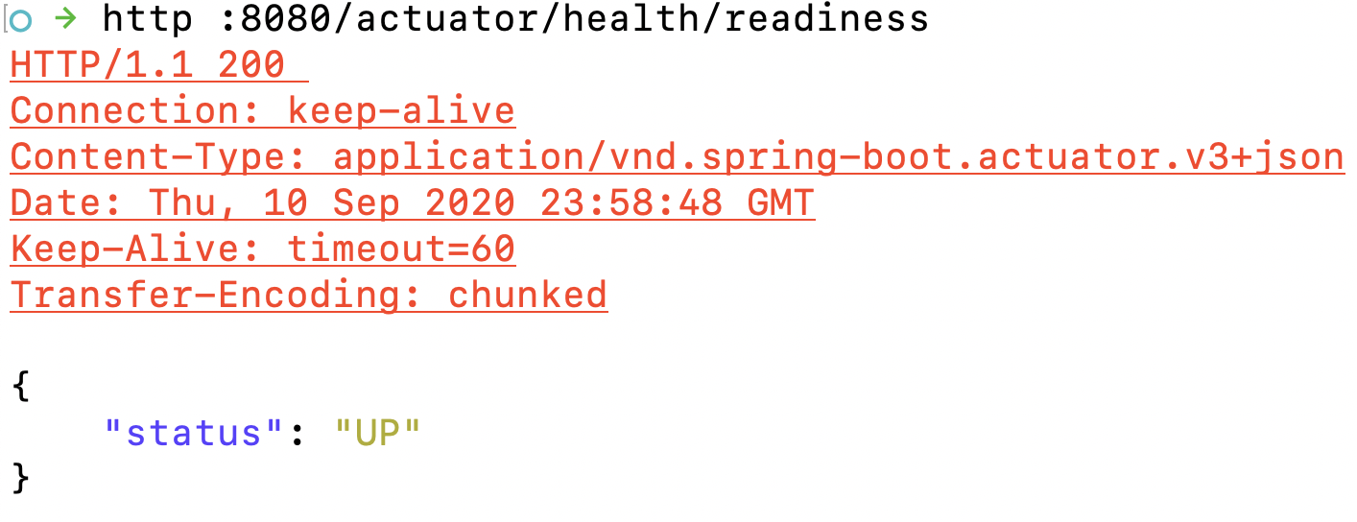
Spring Boot Actuator Kubernetes Liveness Check
Kubernetes sends network traffic to containers with passing liveness checks

Slide 4
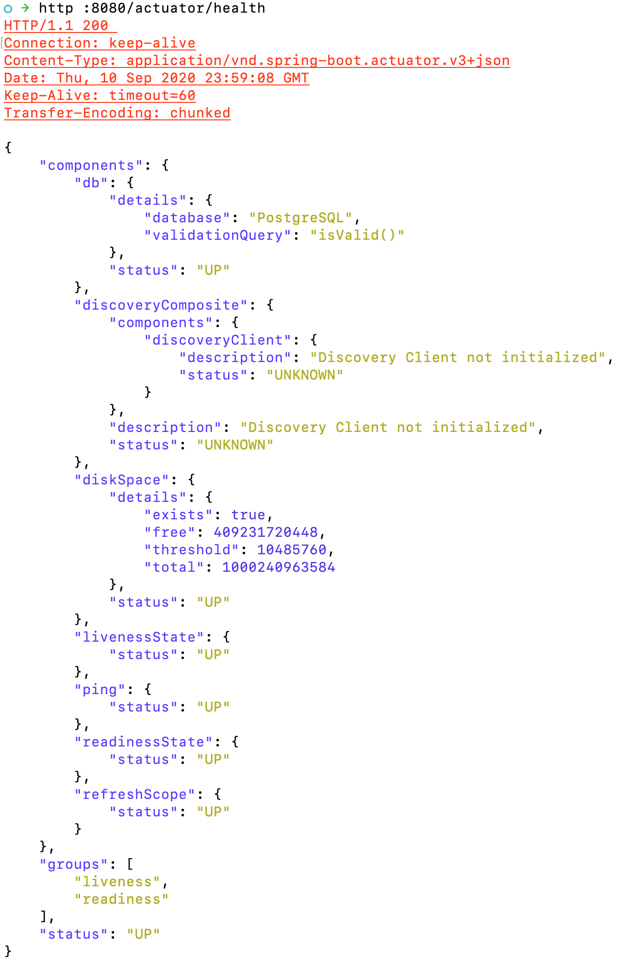
Spring Boot Default Health Check
Spring Boot ships with 16 auto-configured health checks for commonly used dependencies, such as databases, message queues, caches, etc.
Custom Health Indicators provide a simple mechanism to provide application- and environment-specific health checks.

Slide 5

Health Check Demo

Slide 6




Four types of observability
Logging
Health Checks
Metrics
Distributed Tracing

Slide 7
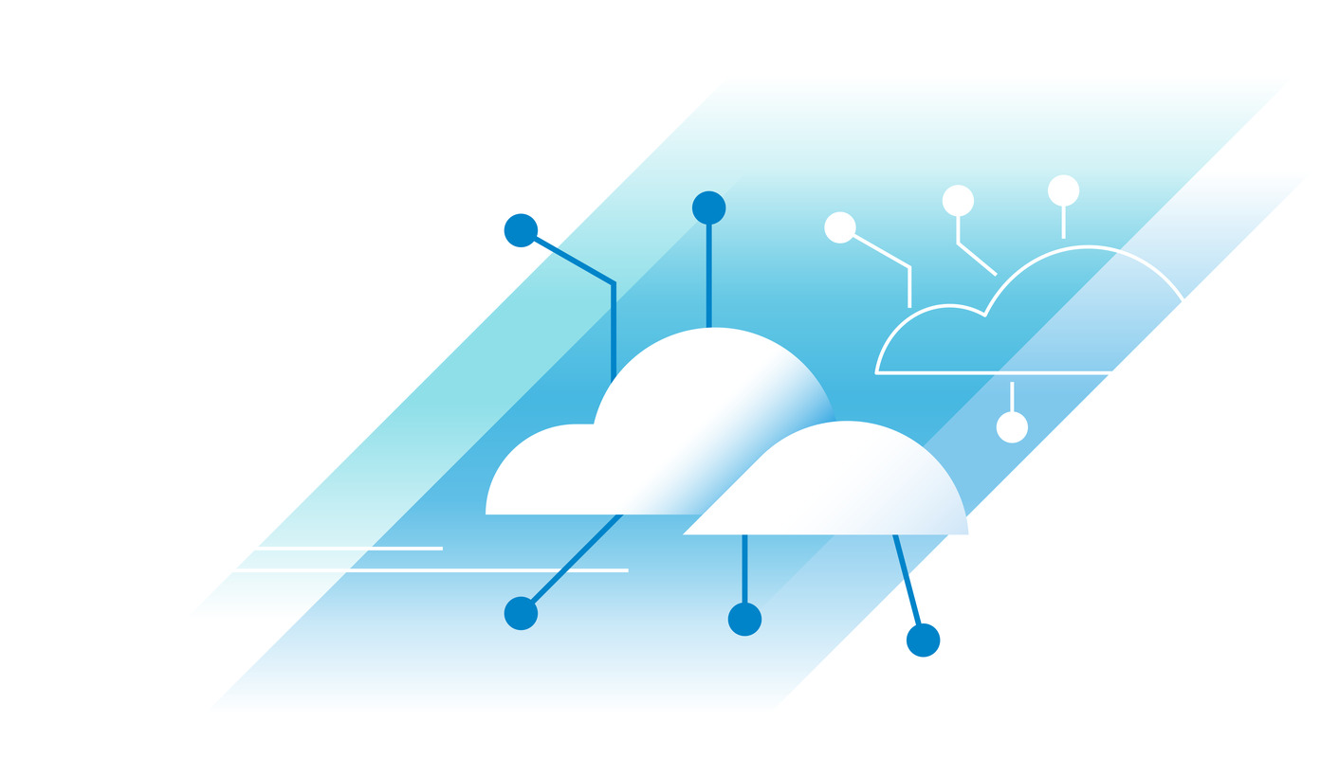
The Problem Context
How can an app expose metrics on its internal state?
How can metrics be tagged to make analysis and dashboarding easy?
How to alert on metrics?

Slide 8
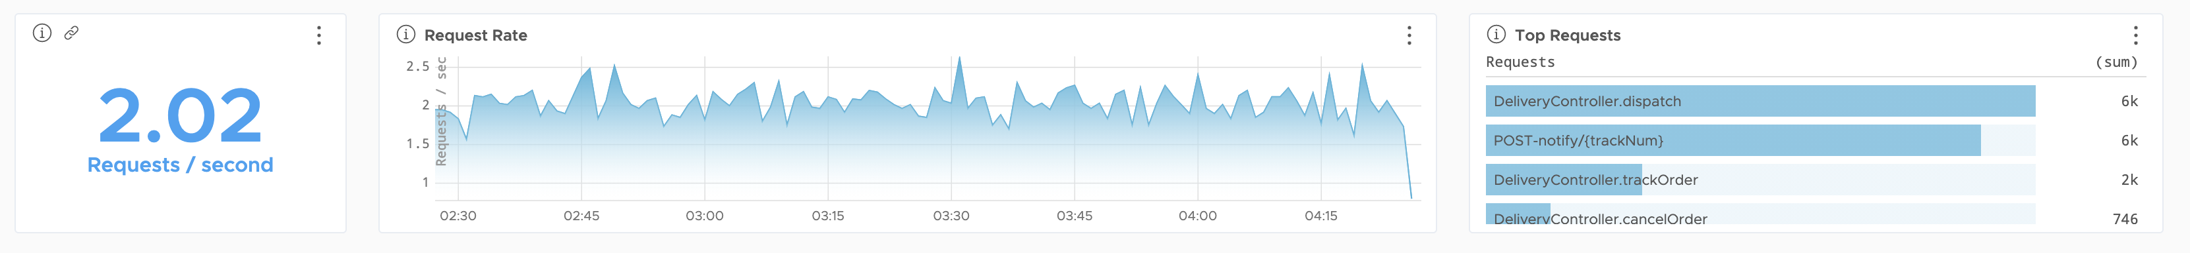
Common Metric Types
Counter − always going up until resent back to 0.
Gauge − current value of a measure that ranges over a min and a max.
Timer − measures how long something took.
Event Distributions & Histograms

Slide 9
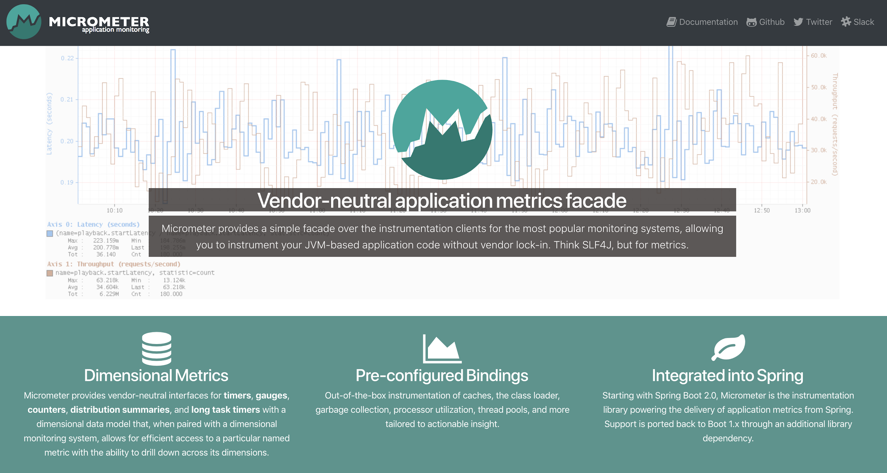
Micrometer.io

Slide 10

Metrics Demo

Slide 11
Four types of observability
Logging
Health Checks
Metrics
Distributed Tracing

Slide 12
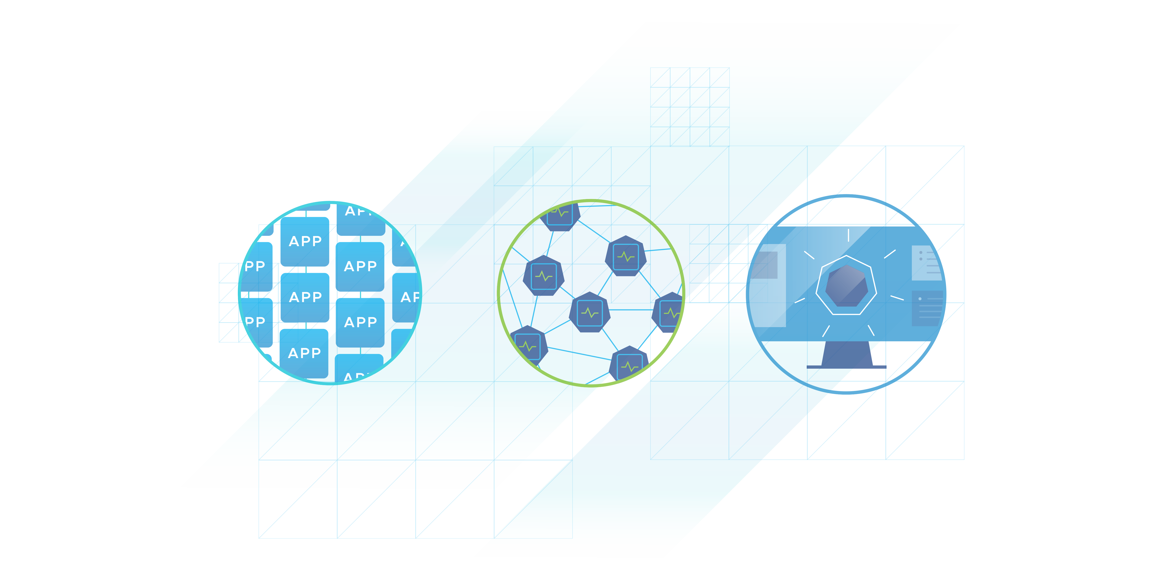
Troubleshooting latency issues
How long did a request take to process?
How do I know if a request is slow?
Why did the request take so long?
How much time did each app take to process the request?

Slide 13
Distributed Tracing
Distributed Tracing is a process of collecting end-to-end transaction graphs in near real time.
A trace represents the entire journey of a request.
A span represents a single operation call.
Tracers add logic to create a unique trace Id, span Id.
Azure App Insights stores and visualizes trace data.

Slide 14
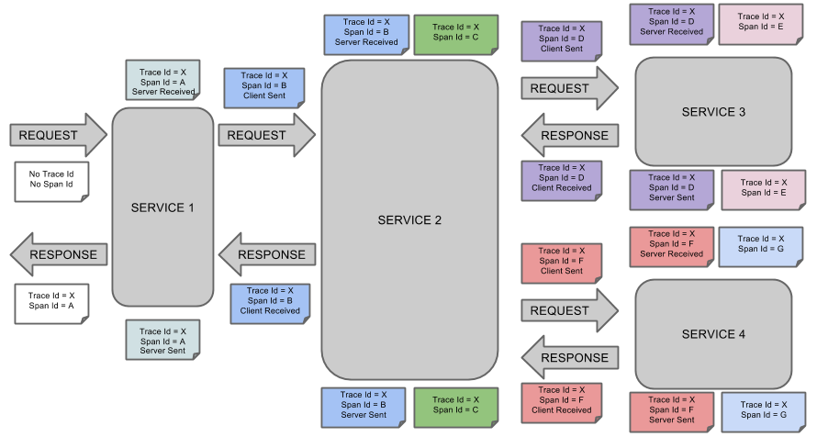
Traces and Spans

Slide 15

Distributed Tracing Demo

Slide 16
Observability is easy on Azure Spring Apps
Logging
Health Checks
Metrics
Distributed Tracing

Slide 17

Demo 6 Effortlessly observe Spring Apps
App map
Operations executed
Performance
End-to-end transactions
Exceptions
Custom metrics
Live metrics
Query logs – app logs, exceptions, gateway | config | registry logs
Application Live View
Notes:
Speaker: Asir

Slide 18
Lab 4 Effortlessly monitor Spring Apps
App map
Operations executed
Performance
End-to-end transactions
Exceptions
Custom metrics
Live metrics
Query logs – app logs, exceptions, gateway | config | registry logs
15 mins

Slide 19
Automation Pipelines and gates on the path to prod dev/uat/staging, etc. Automation patterns − Blue green deployment and automated provisioning
15 mins

Slide 20

Demo 7 Automate blue green deployments
GitHub Actions

Slide 21

Automate from idea to production​
Automate Java on Azure end-to-end using any automation tools and platform
Terraform
ARM
CLI
Maven
Gradle
Tasks
Actions
CLI
Provision
Build
Deploy
Azure Pipelines
GitHub Actions
Jenkins
Notes:
You can build end-to-end automation from idea to production using a wide range of automation tools and platforms.
Typically, we see our customers create pipelines that are broadly classified into 3 categories:
Provisioning pipelines. You can provision Azure resources using Terraform, ARM templates, or the Azure CLI, creating repeatable scripts to spin up and down environments consistently.
Build pipelines support your favorite “build” tools. Use Maven or Gradle to build and store JARs, WARs, or even EARs if you’re feeling nostalgic.
Deployment pipelines use GitHub Actions, Azure Pipelines, and the Azure CLI. Blue/green deployments allow you to keep critical systems in production while deploying updated applications and transitioning seamlessly between them.
© 2022 VMware Inc. and Microsoft Corporation. All rights reserved. MICROSOFT MAKES NO WARRANTIES, EXPRESS, IMPLIED OR STATUTORY, AS TO THE INFORMATION IN THIS PRESENTATION.

